Slide 1




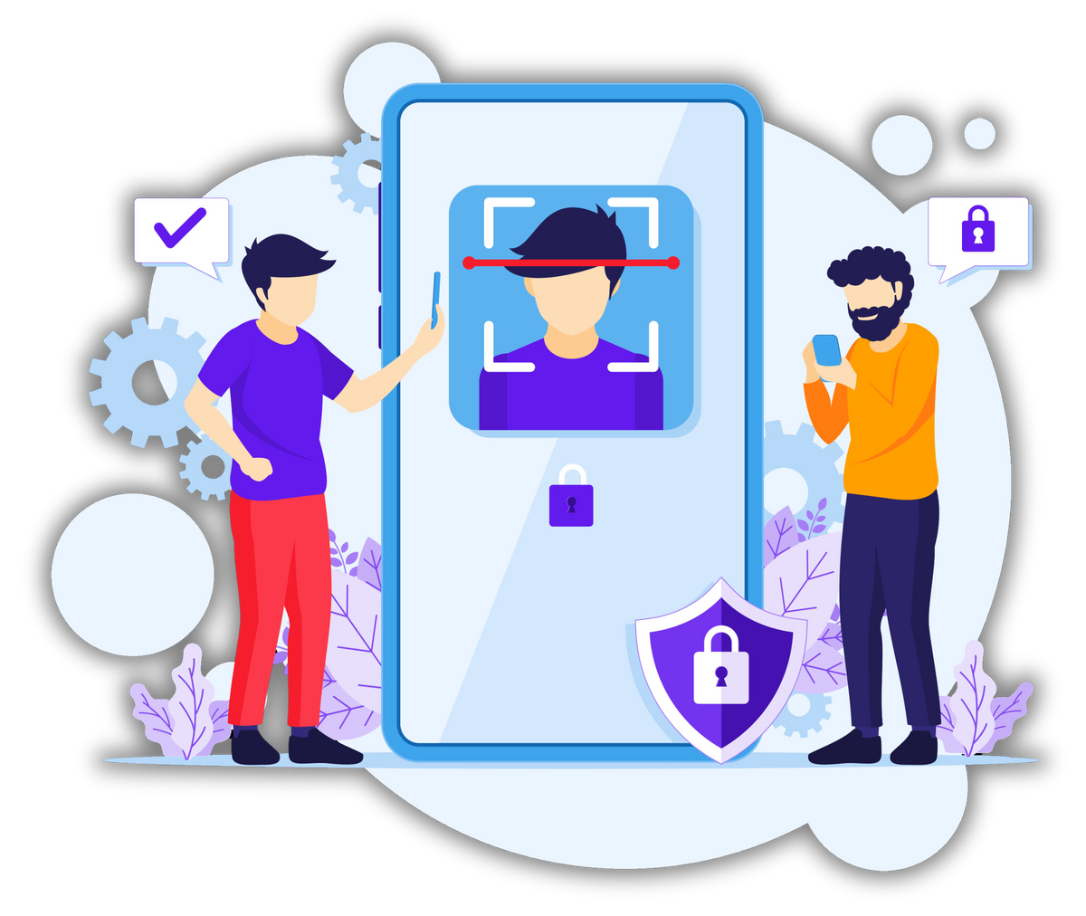


Face
Recognition
ATTENDANCE

Slide 2





OUR TEAM
supervised by :
Dr. Bassem Mohammed
Eng. Rehab Abo El Hassan
Ali Sayed Ali
Reem Kamal
Farha Reda
Mai Mohamed
Hesham Mohamed
Abdelaziz Moawad
Mai El Gaher
2

Slide 3




AGENDA
1
6
DIAGRAMS
ABSTRACT
2
INTRODUCTION
7
DATASET
11
TIMELINE
3
PROBLEM
STATEMENT
8
ALGORITHM
12
CONCLUSTION
4
AIMS & OBJECTIVES
9
SYSTEM
ARCHITECTURE
13
REFERENCES
5
10
METHODOLOGY
DESIGN
3

Slide 4


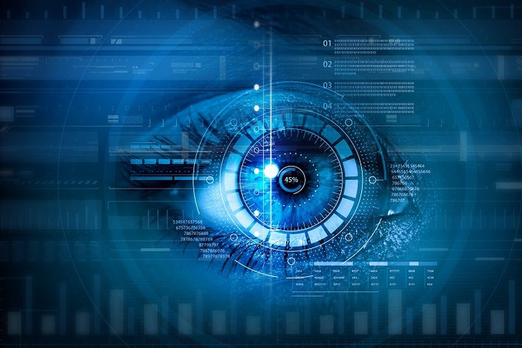


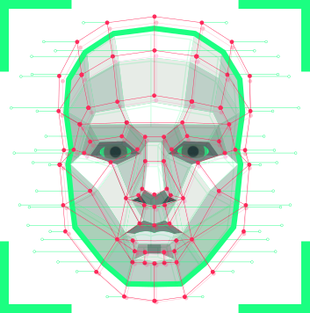
ABSTRACT
Face recognition, fingerprint recognition, and other biometric authentication methods are gradually becoming the most promising means for identifying a person's face. We can use them in our phones, laptops, offices, and other devices. However, pupils' attendance is still taken manually, which takes a long time and is extremely inefficient. To preserve that valuable time, we needed an automated operating attendance system that eliminated all of the drawbacks of collecting attendance on paper. We're putting together a system that's both efficient and dependable. we created a face recognition-based attendance system. We can apply our attendance system anywhere, For face detecting and recognizing.
4

Slide 5


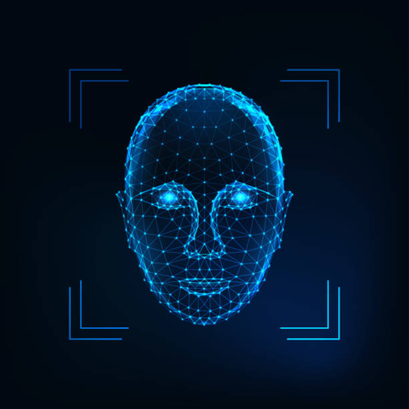
INTRODUCTION
Human face is the most significant component of the human body for identifying a person. Face recognition is another type of biometric recognition that maintains all of a person's facial traits as distinct face prints in order to uniquely identify them. Biometric face recognition has received a lot of traction among researchers due to its versatility and usefulness. Also its contact free procedure, that is why it outsmarts all other recognitions like fingerprint, iris print and palm print. Face recognition technology is also able to detect a person from far away, without coming in physical contact with The photo that has been captured will be keep in the database. After that we can use this project in many ways like face recognition systems will be used in schools, Universities, companies and any other organization to record the attendance with high speed and accuracy.
5

Slide 6


PROBLEM STATEMENT
Traditional attendance systems, such as manual roll calls or card-based methods, are often time-consuming, prone to errors, and vulnerable to fraudulent practices like proxy attendance. These methods lack efficiency, especially in large organizations, and require significant administrative effort. Additionally, manual systems are not scalable and fail to provide real-time tracking or integration with other management tools. Inconsistent data recording further complicates attendance management and impacts operational effectiveness. There is a need for a secure, automated solution that ensures accuracy, prevents fraud, and streamlines the attendance process. Face recognition technology addresses these challenges by offering a fast, reliable, and adaptable alternative.
6

Slide 7

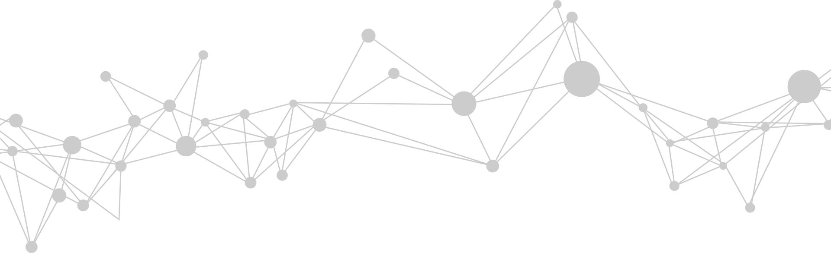
AIMS AND OBJECTIVES
The Face Recognition Attendance System aims to revolutionize attendance tracking by leveraging advanced facial recognition technology. Its primary objective is to automate the process, ensuring accurate and real-time identification of individuals. By eliminating traditional manual or card-based methods, the system enhances efficiency, saves time, and minimizes errors. It is designed to handle diverse environments with adaptability to variations in lighting and expressions. Additionally, This innovative approach not only simplifies attendance management but also prevents fraud and boosts overall operational efficiency.
7

Slide 8
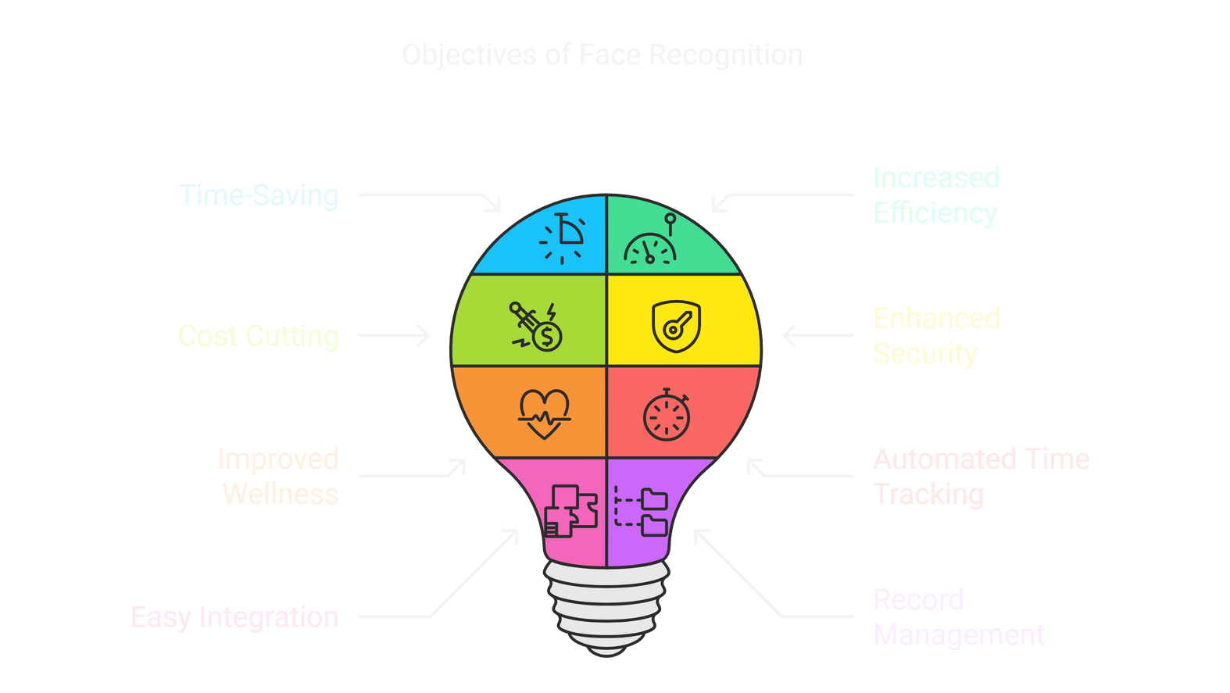




# CONTINUE : OBJECTIVES
Time-Saving For Your Workforce
Increased Efficiency and Capability
Cost Cutting And Saves Money
Enhances Workplace Security
Improved Employee Wellness And Productivity
Automated Time Tracking
Easy Integration With Other Systems
Easy To Manage Records
8

Slide 9


METHODOLOGY
We used Agile Model to build a face recognition attendance system ,because It ensures iterative development, allowing for continuous improvements based on user feedback. Features include real-time facial authentication, automated attendance logging, integration with HR systems, and fraud detection. Agile promotes flexibility, enabling quick adaptation to security enhancements and accuracy improvements. Regular sprints help refine AI models and optimize performance efficiently.
9

Slide 10
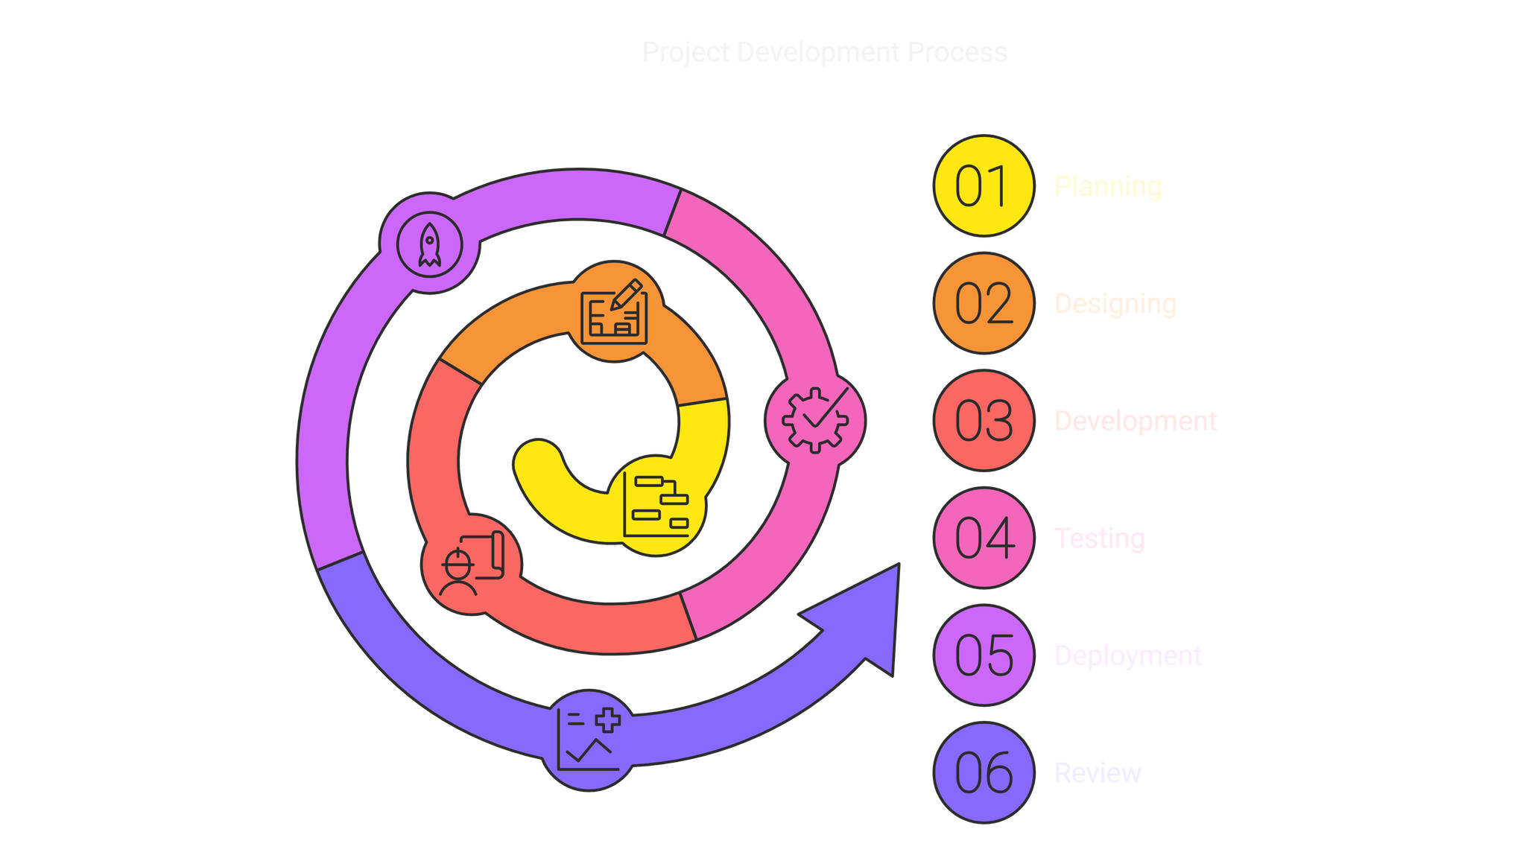
# CONTINUE : METHODOLOGY
10

Slide 11




# CONTINUE : METHODOLOGY
Planning
Objective: Define the system's requirements and objectives.
Tasks:
Identify the need for an automated attendance system.
Gather requirements from stakeholders (e.g., administrators, users).
Define functional requirements (e.g., face detection, attendance logging) and non-functional requirements (e.g., accuracy, scalability).
Hi
11

Slide 12


# CONTINUE : METHODOLOGY
Design
Objective: Design the system architecture and components.
Tasks:
Define the system architecture (e.g., input module, face detection module, database module).
Select the technology stack (e.g., Python, OpenCV, SQLite).
Design the database schema (e.g., Users Table, Attendance Table).
Create workflow diagrams (e.g., how the system processes images and logs attendance).
Development
Objective: Develop the system based on the design.
Tasks:
Set up the development environment.
Implement face detection using OpenCV or Dlib.
Implement face recognition using libraries like face_recognition or DeepFace.
Develop the database module to store facial data and attendance records.
Create the attendance logging module.
Build the user interface for administrators.
12

Slide 13





# CONTINUE : METHODOLOGY
Testing
Objective: Verify that the system meets the requirements and works as expected.
Tasks:
Test face detection and recognition accuracy under various conditions (e.g., lighting, angles, occlusions).
Validate attendance logging and report generation.
Perform stress testing to evaluate system performance under heavy load.
Deployment
Objective: Deploy the system in a real-world environment.
Tasks:
Install the system on local machines or servers.
Configure the system for cloud deployment (if required).
Train administrators and users on how to use the system.
13

Slide 14

# CONTINUE : METHODOLOGY
Review
Objective: Ensure the system remains functional and up-to-date.
Tasks:
Fix bugs and issues reported by users.
Update the facial database as new users are added.
Improve the system based on user feedback and advancements in face recognition technology.
14

Slide 15
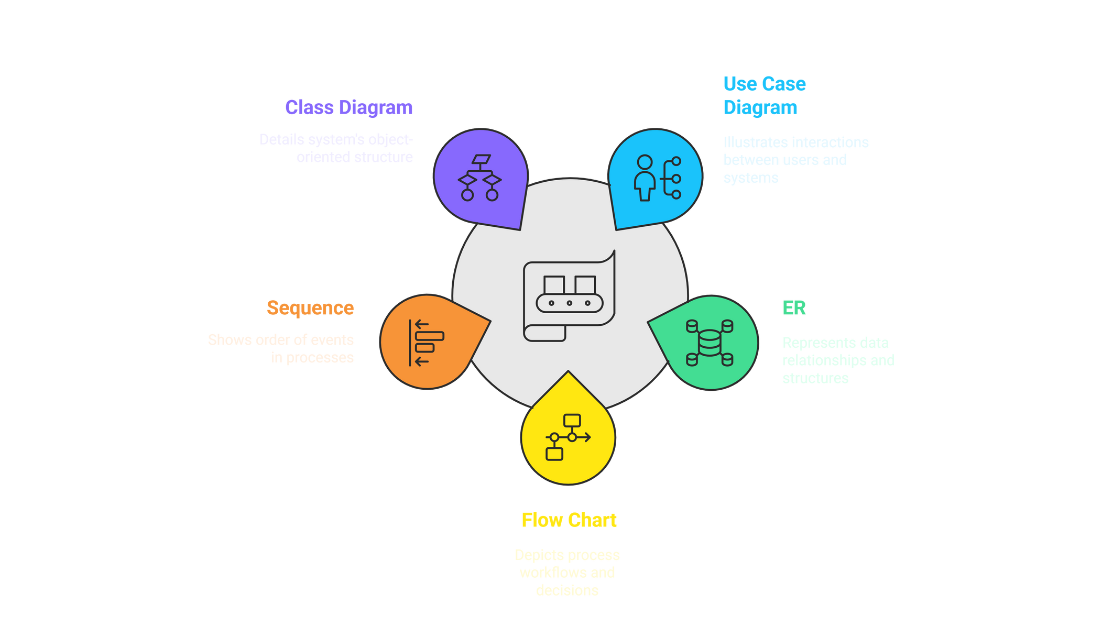

DIAGRAMS
15

Slide 16

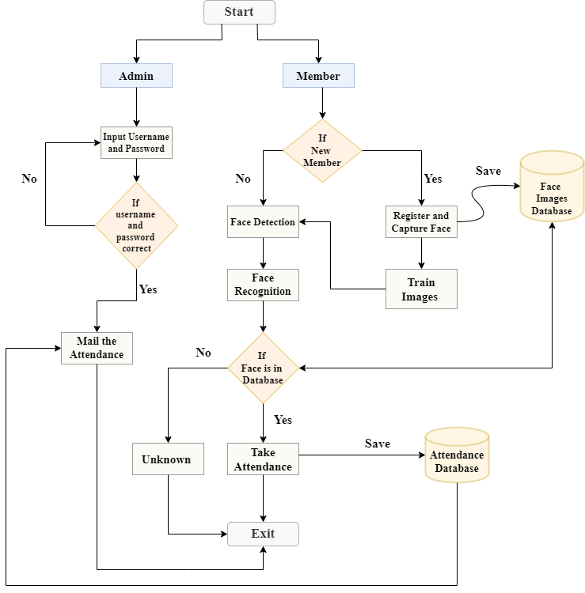

FLOWCHART DIAGRAM
16

Slide 17
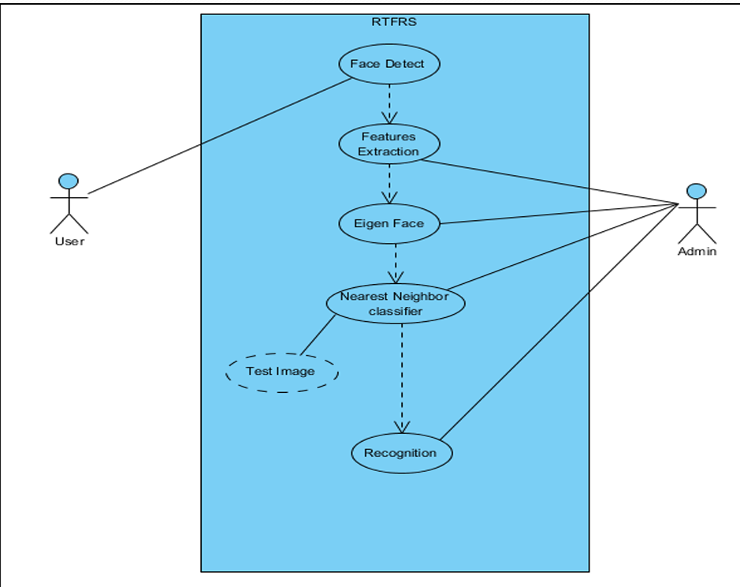
Use Case
diagram
17

Slide 18
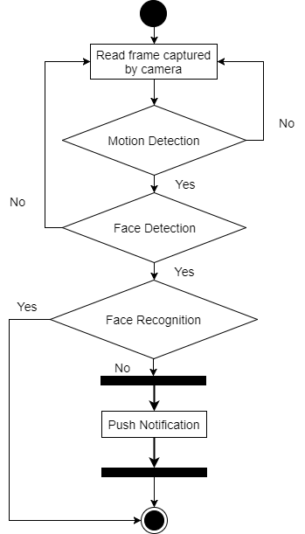
Activity
diagram
18

Slide 19
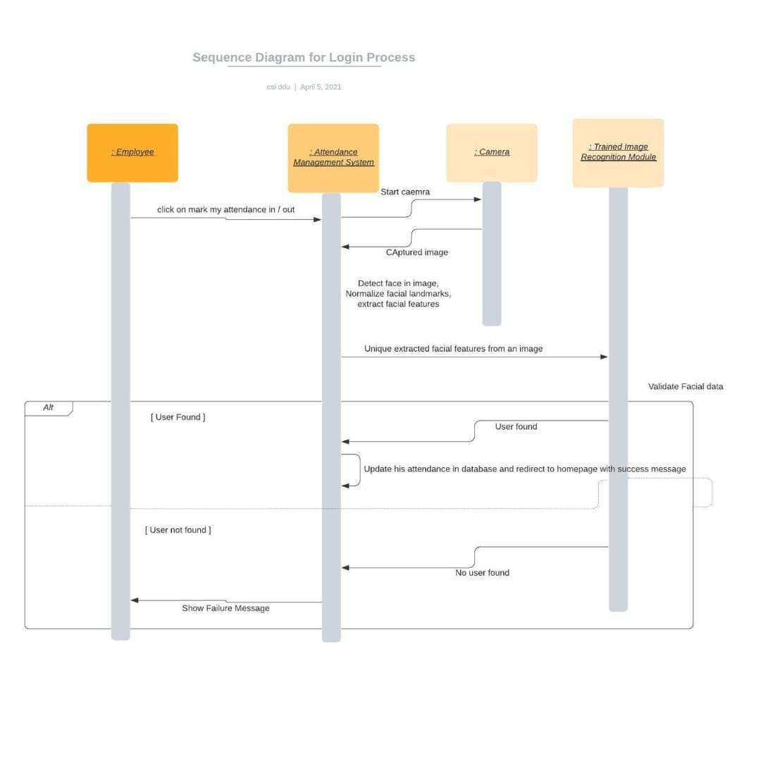
Sequence
diagram
19

Slide 20
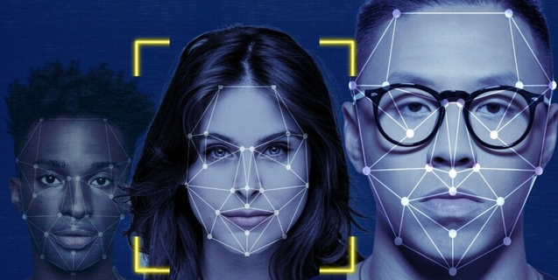

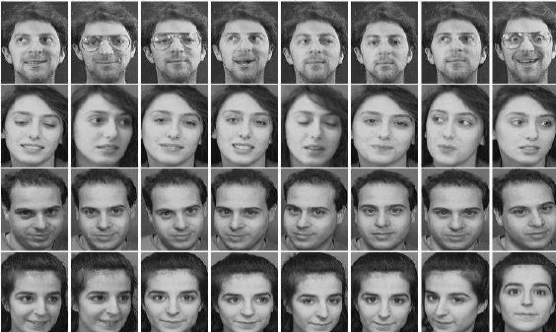
DATASET
Self-Made Dataset
A self-made face dataset is a custom collection of facial images captured and labeled specifically for your project, ensuring high relevance and control over data quality. It allows you to tailor the dataset to your environment, lighting, and user base for better model performance.
20

Slide 21


# CONTINUE : DATASET
1. Customization for Your Specific Task
2. Improved Data Quality
3. Avoid Licensing Issues
4. Better Generalization
5. Data Augmentation and Experimentation
6. Privacy and Security
21

Slide 22
ALGORITHM
OpenCV+Mediapipe
We used MediaPipe for face detection and OPenCV for face processing, we can build highly efficient, real-time, and accurate face recognition systems. This combination is widely used in applications like biometric authentication, smart surveillance, and automated attendance tracking.
22

Slide 23
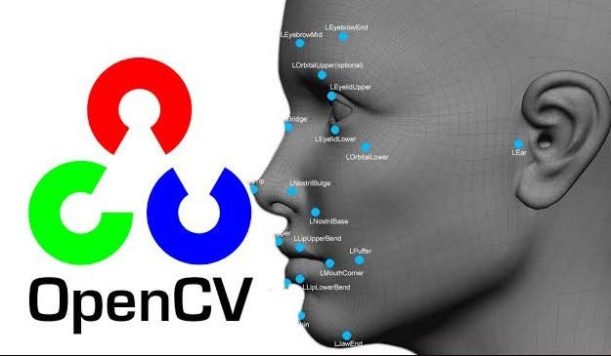
ALGORITHM
OPenCV
Image processing – Edit and analyze images (resize, filter, etc.).
Video capture – Work with live or recorded video.
Face detection – Detect faces and objects in images.
Machine learning – Built-in tools for training simple models.
Camera access – Connect and use webcams easily.
Cross-platform – Runs on many systems (Windows, Linux, mobile).
23

Slide 24
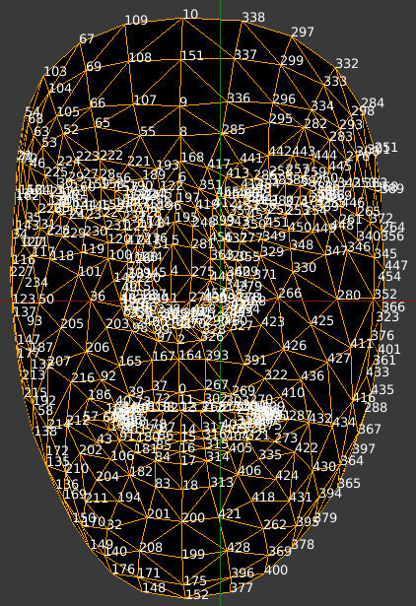
ALGORITHM
MediaPipe
Fast & Lightweight – Runs in real time with minimal computational power.
Cross-Platform – Works on Android, iOS, web, and desktop.
Robust Face Detection – Handles various lighting conditions and angles.
Multi-Face Tracking – Detects and tracks multiple faces simultaneously.
Optimized for Low Power Devices – Ideal for embedded systems like Raspberry Pi.
24

Slide 25
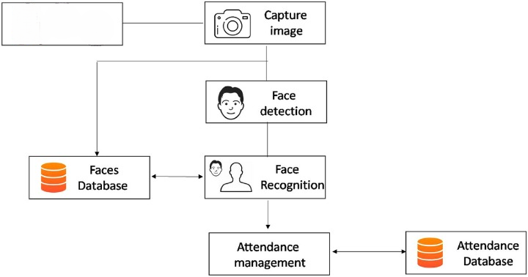

SYSTEM
ARCHITECTURE
user
25

Slide 26
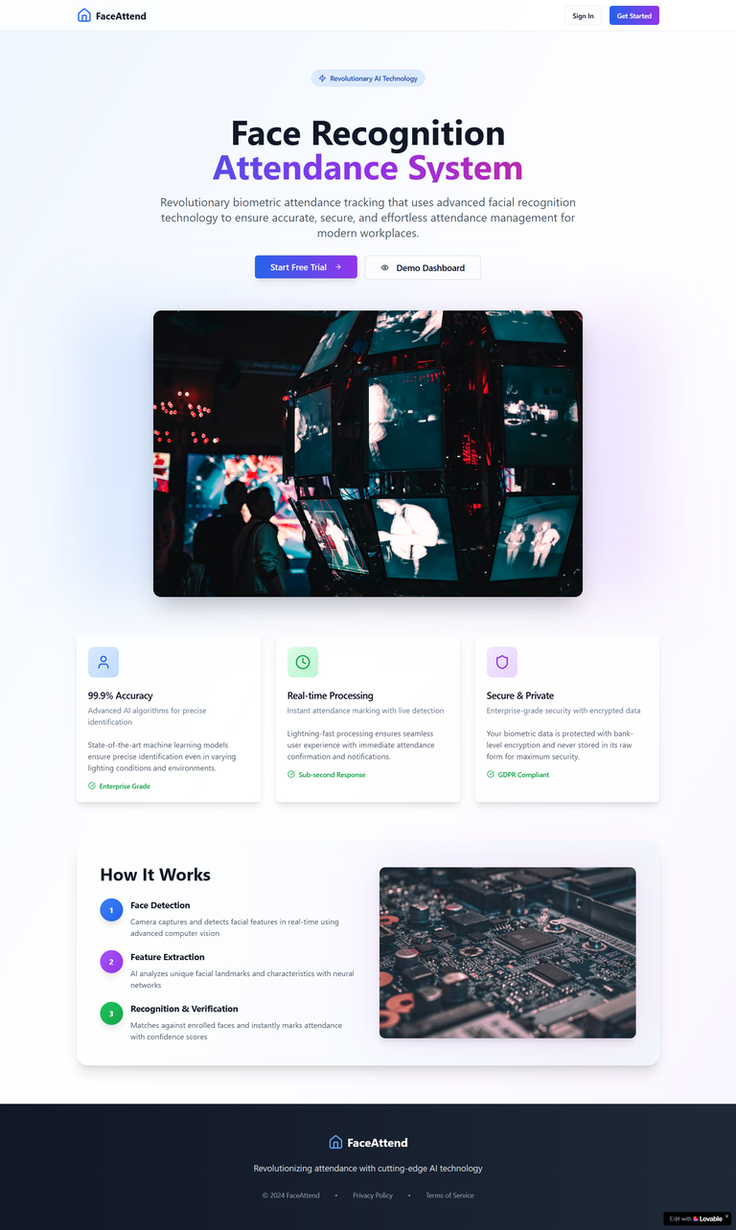
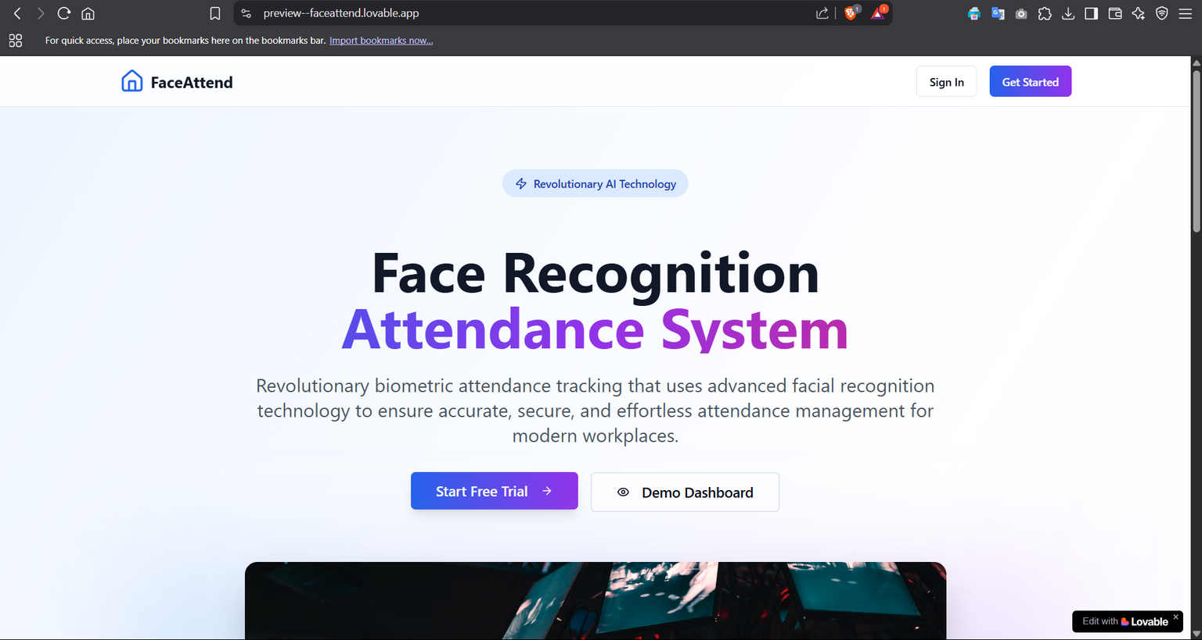
DESIGN
Home page
26

Slide 27
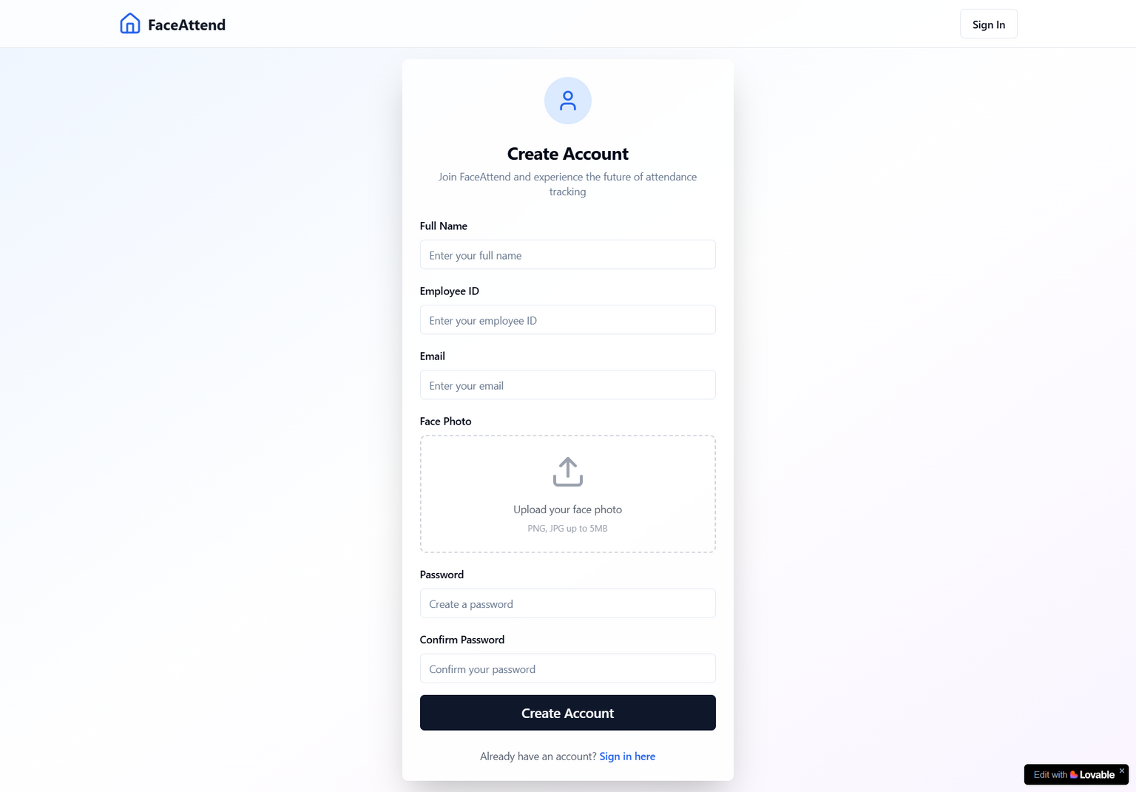
Registration
DESIGN
27

Slide 28
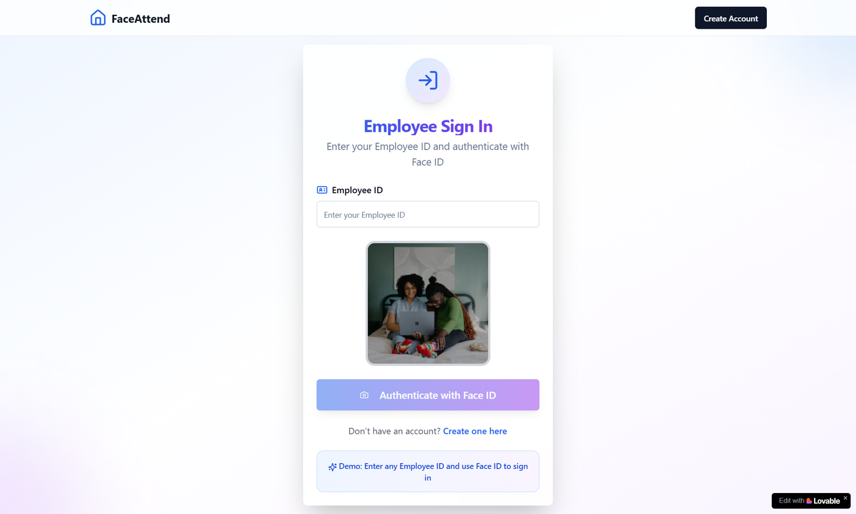
DESIGN
Login
28

Slide 29
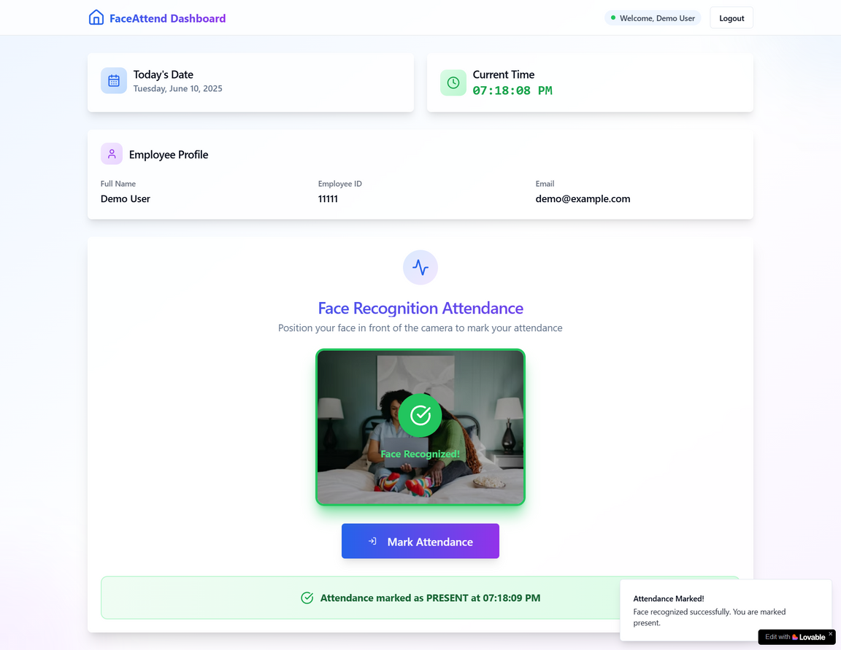
DESIGN
Dashboard
At end of this Process
you will be in the last of part of our site
Dashboard
You are present 😊✅
29

Slide 30
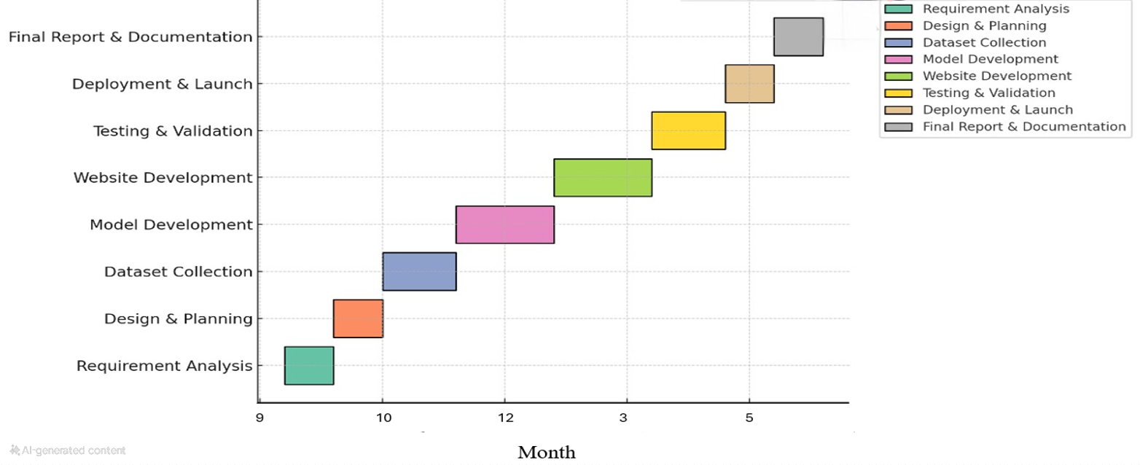

TIMELINE
30

Slide 31


CONCLUSION
Efficiency and Security: Face recognition attendance systems provide a modern, efficient, and secure way to track attendance, reducing errors, fraud, and administrative workload.
Privacy and Ethical Concerns: Implementation requires addressing privacy, data security, and ethical issues to ensure responsible and fair usage.
Future Potential: With advancements in AI and facial recognition technology, these systems are expected to become more accurate, secure, and widely adopted.
31

Slide 32







REFERENCES
chrome-extension://efaidnbmnnnibpcajpcglclefindmkaj/https://www.iraqoaj.net/iasj/download/efad9cfd2c80b04a
chrome-extension://efaidnbmnnnibpcajpcglclefindmkaj/https://ece.anits.edu.in/Project%20Reports%202020-21/Sec-B/B-13.pdf
chrome-extension://efaidnbmnnnibpcajpcglclefindmkaj/https://www.elmar-zadar.org/2005/elmar2005_torres.pdf
https://ieeexplore.ieee.org/document/9145558
32

Slide 33

Thank You!

